Slide 1

Basic Solutions Concepts (pt 2)
Chris Kiekintveld

Slide 2
Best Response
If you knew what all of the other players were going to do, it is (relatively) easy to decide what to do
Essentially, this just becomes a single-agent decision problem
Finding the action that maximizes the expected value against the opponent action profile is called “best response”

Slide 3
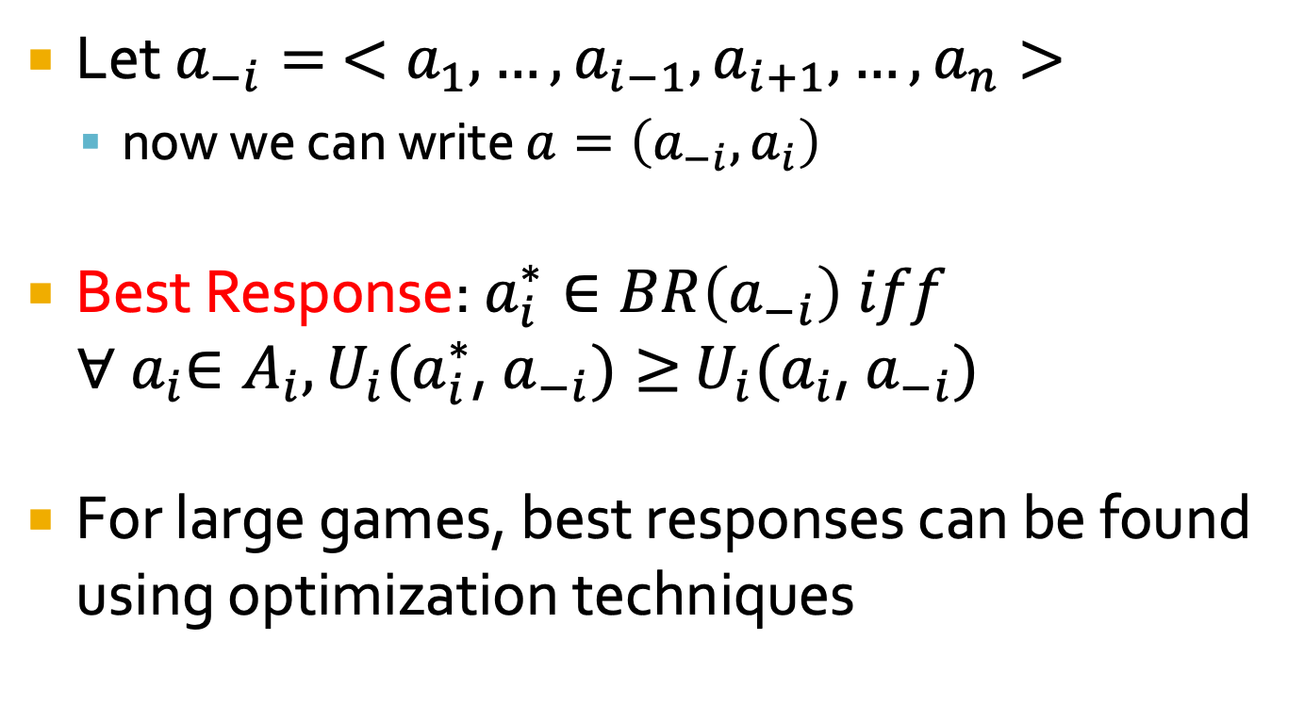
Best Response
Let $a_{−i}= <a_{1},…,a_{i−1},a_{i+1},…,a_{n}>$
now we can write $a=\left(a_{−i},a_{i}\right)$
Best Response: $a_{i}^{∗}∈BR\left(a_{−i}\right) iff$
$∀{ a}_{i}∈A_{i}, U_{i}(a_{i}^{∗}$, $a_{−i})≥$ $U_{i}(a_{i}$, $a_{−i})$
For large games, best responses can be found using optimization techniques

Slide 4
Nash Equilibrium
Now let’s return to the setting where the players do not know anything directly about what the other players will do
What can we say about what actions will be played?
Players must predict what the other players will do and play a response
Variations on how to do both of these

Slide 5
Nash Equilibrium
Key idea: players are rational and should make correct decisions
Correctly predict what other players will do
Correctly play a best response to that prediction
Nash equilibria are strategy profiles that meet these conditions for all players
”Stable” profiles where no player wants to change

Slide 6
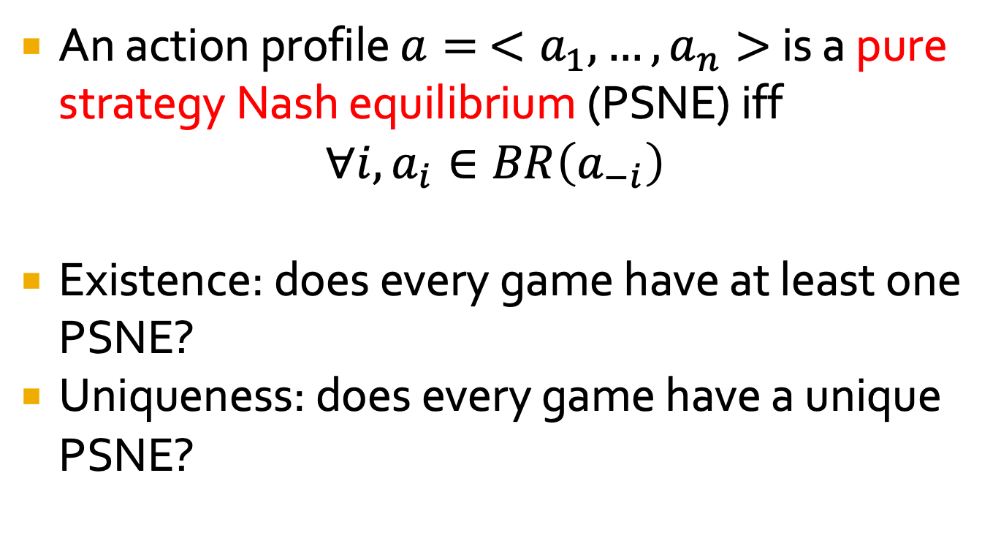
Pure Strategy Nash Equilibrium (PSNE)
An action profile $a= <a_{1},…,a_{n}>$ is a pure strategy Nash equilibrium (PSNE) iff $∀i, a_{i}∈BR\left(a_{−i}\right)$
Existence: does every game have at least one PSNE?
Uniqueness: does every game have a unique PSNE?

Slide 7
Finding PSNE
Idea for a basic algorithm:
For each player, identify the action that is the best response to every opponent action
Any outcome where ALL actions are a best response is a PSNE

Slide 8
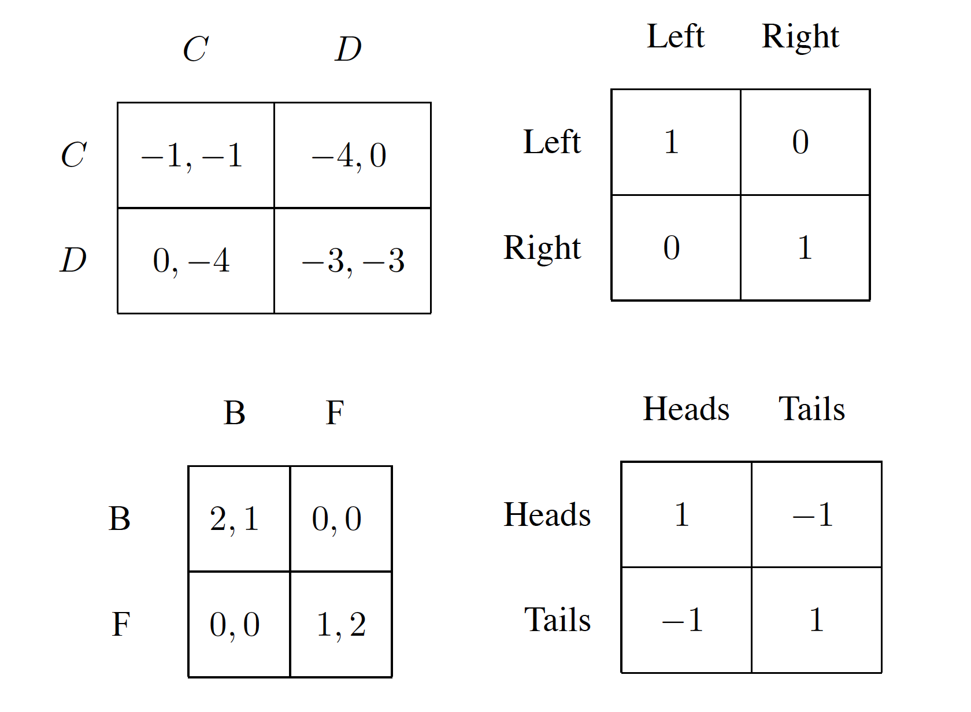
Nash Equilibria in Canonical Games

Slide 9
Nash Equilibria in Canonical Games
*
*
*
*

Slide 10
Nash Equilibria in Canonical Games
*
*
*
*
Paradox of the Prisoner’s Dilemma: Nash equilibrium is the only Pareto-Optimal outcome!

Slide 11
Nash Equilibria in Canonical Games
*
*
*
*

Slide 12
Nash Equilibria in Canonical Games
*
*
*
*

Slide 13
Nash Equilibria in Canonical Games
*
*
*
*

